Slide 1

Internal Microservice Communication
Data Transfer Patterns Between Multiple Servers
SoftUni Team
Technical Trainers
Software University
https://softuni.bg

Slide 2
Table of Contents
Consistency Between Services
Communication Between Services
Communication Types
Communication Patterns
Using A Message Broker

Slide 3
Questions
sli.do #microservices

Slide 4

Consistency Between Services

Slide 5
Consistency Between Services
The challenge is to implement end-to-end business processes while keeping consistency across microservices
Catalog microservice - maintains information about products (including price)
Shopping Cart microservice - maintains current chosen products and price
When a product price is updated - you need to update the cart too (and show a message)

Slide 6
Consistency Between Services
In monolithic application this should be fairly easy
But with microservices - no service should include tables/storage from another one
And it should never call direct queries to them
The solution is event-based communication
Publish-Subscribe pattern

Slide 7
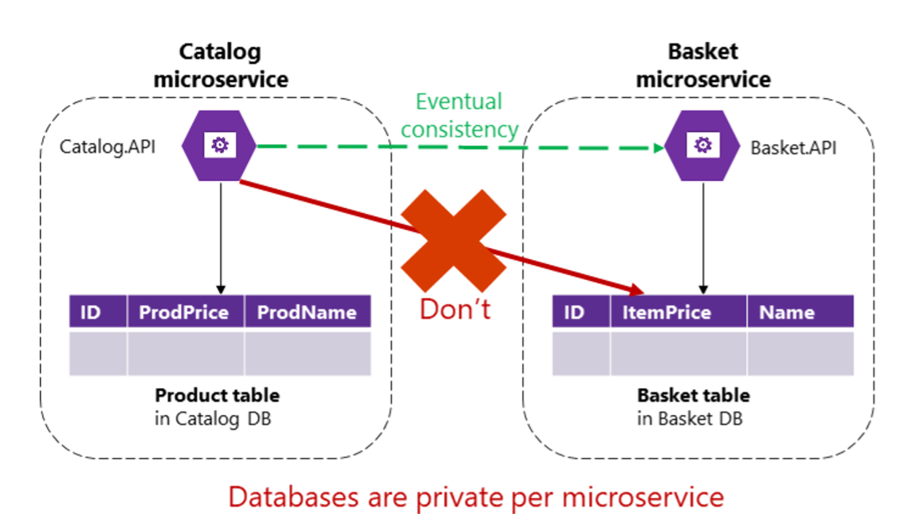
Consistency Between Services

Slide 8
Communication Between Services

Slide 9
Communication Between Services
The challenge about communication is not so much about the protocols
But more about the style and couplings
Because when failure occurs - the more coupled the system, the bigger issues you will have
Partial failures will happen, so you need to design the system considering the common risks

Slide 10
Communication Between Services
Popular approach is HTTP, because it is simple
HTTP is perfectly acceptable, but it depends on how you use it
Acceptable HTTP requests are
Client-Microservice
Client-API Gateway
API Gateway-Microservice
Unacceptable HTTP requests are
Microservice-Microservice

Slide 11
Communication Between Services
Consider the following scenario
The client call the Orders microservice
Then the Orders microservice calls additional microservices for more information
Sounds reasonable at first

Slide 12
Communication Between Services
These are the pitfalls
Blocking and low performance - scalability is impacted
HTTP coupling on a business level - this should not occur
Failure will be difficult to manage - and failures occur
This way - we achieve a monolithic application across many processes
Solution is event-driven asynchronous communication

Slide 13
Communication Types

Slide 14
Communication Types
Sync or Async
Synchronous - HTTP/HTTPS - tasks can continue after the response
Asynchronous - AMQP - the client usually don't expect a response
Single or Multiple receivers
Single receiver - the Command pattern
Multiple receivers - the Publish/Subscribe pattern

Slide 15
Communication Types
Microservices usually uses a combination of these communication types
If possible, never depend on request-response communication
It breaks the autonomous feature of the microservices
And may turn into a bottleneck
Always consider "the rule of 1 hop"

Slide 16
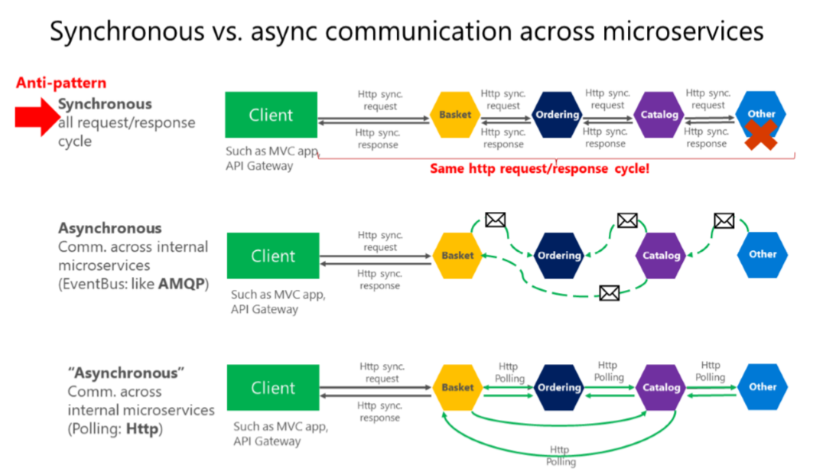
Communication Types

Slide 17
Communication Patterns

Slide 18
Communication Patterns
Don't rely on request-response, if possible
If you need data from another microservice, consider duplicating it, it's perfectly OK!
If your microservice needs to invoke an action in another microservice do it asynchronously
You can use any protocol to transfer data to have eventual consistency
But don't create synchronous dependencies by waiting for responses

Slide 19
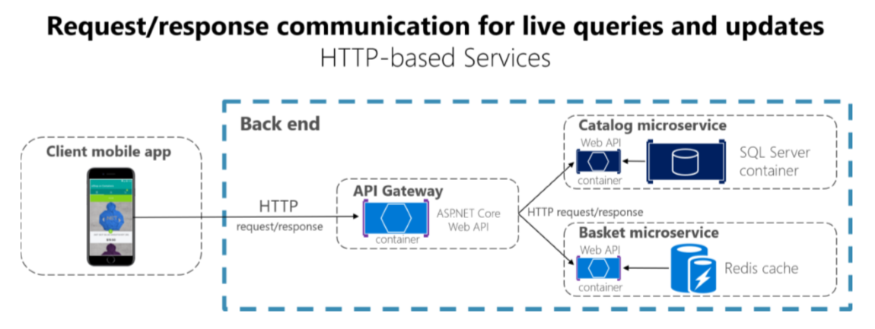
HTTP And REST
Suitable for UI needs and fast responses
Usually used for queries

Slide 20
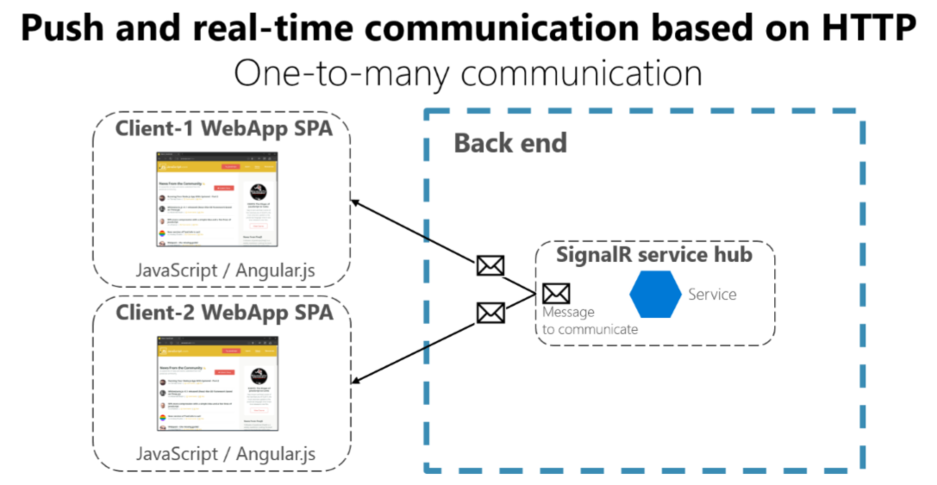
Web Sockets & SignalR
Suitable for real-time UI data

Slide 21
Asynchronous Messages
Critical for propagating changes throughout multiple services
Eventual consistency + event-driven communication
A client send a message (header and body) and do not expect a response
If the service needs to return a response - it sends another message
Usually sent asynchronously through AMQP

Slide 22
Asynchronous Messages
The preferred infrastructure is a lightweight message broker
Like RabbitMQ or a cloud-ready service bus
The rules are
Use HTTP for client + API Gateway + First microservice level (Frontend microservices)
Use AMQP for service level (Backend microservices)

Slide 23
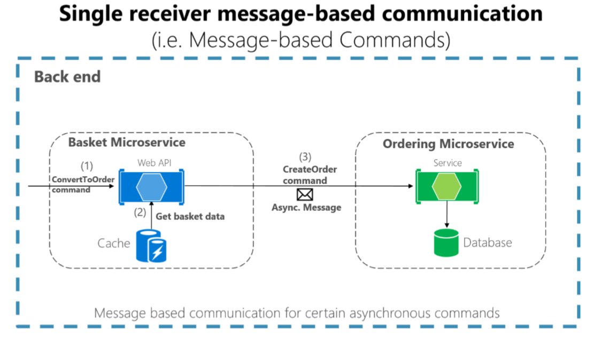
Single Receiver

Slide 24
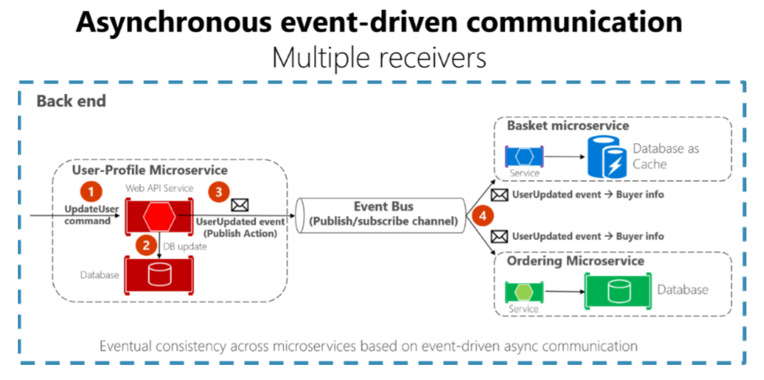
Multiple Receivers

Slide 25
Asynchronous Messages - Problems
The operation is not atomic
What will happen, if the network fails?
Possible solutions
Transaction log mining
Creates coupling to the database
The Event Sourcing pattern
The full pattern requires serious rearchitecting
The Outbox pattern
A separate table, holding the events, part of the transaction

Slide 26
Using A Message Broker

Slide 27
Installing RabbitMQ
Go to https://www.rabbitmq.com/
Follow the guide to install the message broker for your operational system
You may need to install Erlang too
You can configure its port and user access, but it is not required for a development environment
Make sure RabbitMQ is up and running

Slide 28
Configuring MassTransit
MassTransit.AspNetCore
MassTransit.RabbitMQ
Should be added to all web projects
Register the RabbitMQ broker with MassTransit in your services
Create your message classes
Create your consumer classes
And register them in your MassTransit configuration

Slide 29
Adding SignalR
SignalR fits perfectly with event-driven communication
Useful when you want to push data to the client
You may install it in one of your microservices
Or in a separate dedicated SignalR server

Slide 30

Summary
Consistency Between Services
Communication Between Services
Communication Types
Communication Patterns
Using A Message Broker
…
…
…

Slide 31
Questions?
Notes:
31

Slide 32

License
This course (slides, examples, demos, exercises, homework, documents, videos and other assets) is copyrighted content
Unauthorized copy, reproduction or use is illegal
© SoftUni - https://about.softuni.bg/
© Software University - https://softuni.bg
Notes:
32

Slide 33
Trainings @ Software University (SoftUni)
Software University - High-Quality Education, Profession and Job for Software Developers
softuni.bg, about.softuni.bg
Software University Foundation
softuni.foundation
Software University @ Facebook
facebook.com/SoftwareUniversity
Software University Forums
forum.softuni.bg
Notes:
33

